Slide 1


SMART INDIA HACKATHON 2024
SCADA-Map
Problem Statement ID - SIH1708
Problem Statement Title - Tool for secure
automatic network topology creation
Theme - Miscellaneous
PS Category - Software
Team ID - 5900
Team Name - DenQueue

Slide 2

SCADA-Map
DenQueue
Detailed Explanation
Secure Topology Discovery:
Leverages EIGRP routing data for accurate and real-time network mapping.
Eliminates the security risks associated with CDP/LLDP, ensuring a more robust and protected network infrastructure.
AI-Powered Anomaly Detection:
Employs AI-driven models to continuously analyze network traffic and device behavior.
Proactively identifies suspicious activities, unauthorized devices, and potential security threats.
AI/ML Authentication:
Utilizes AI/ML technology to verify device identities and ensure only authorized devices can access the network.
Enhances security and prevents unauthorized access, safeguarding critical SCADA infrastructure.
Scalability for Large Networks:
Designed to accommodate vast networks, spanning thousands of kilometers.
Offers distributed architecture for local enforcement of security while maintaining centralized control.
Real-Time Visualization and Alerts:
Provides an interactive web-based interface for real-time monitoring of network topology and device status.
Generates instant alerts for anomalies or unauthorized access attempts, enabling prompt response and efficient network maintenance.
How It Addresses The Problem
Accurate Device Identification:
Avoids insecure protocols like CDP/LLDP.
Uses syslog, EIGRP for reliable device and connection information.
Real-Time Network Topology:
Provides up-to-date network maps.
Uses routing protocols for instant updates, aiding troubleshooting and security.
Network Security Across Large Areas:
Combines AI anomaly detection and ML-based device authentication.
Dynamically segments the network to isolate threats and prevent unauthorized access.

Slide 3
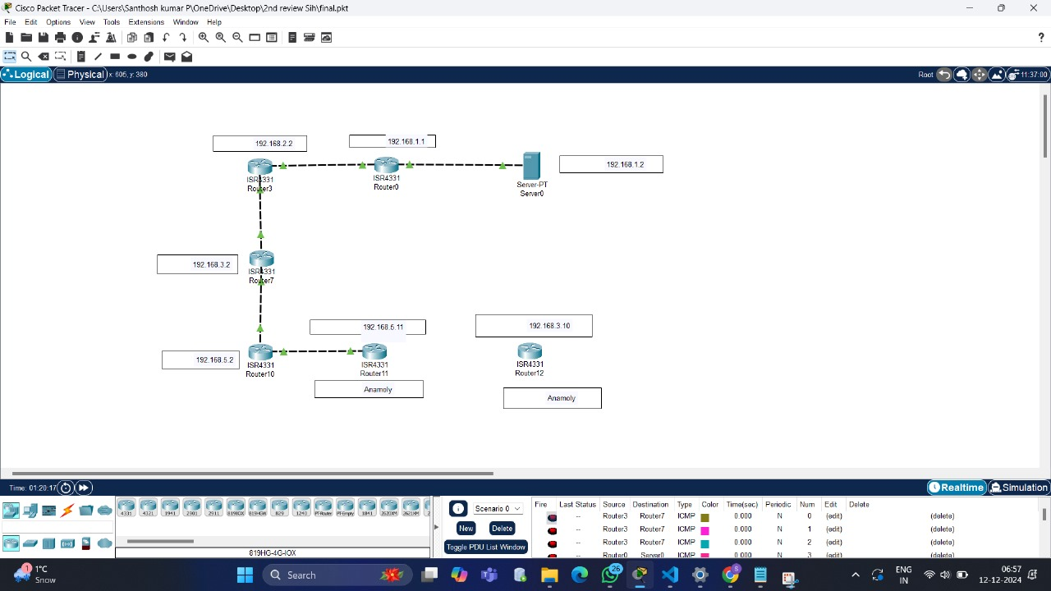
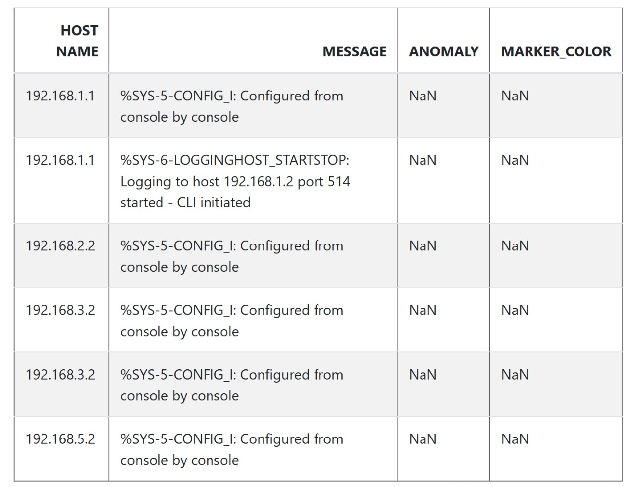
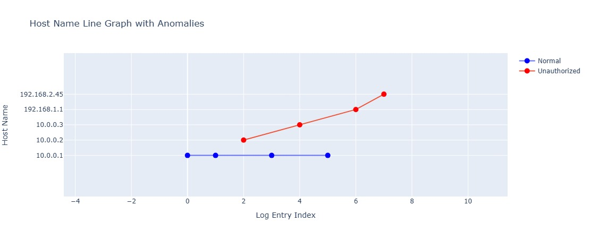
TECHNICAL APPROACH
DenQueue
FLOWCHART
TECH STACK
Front-End: HTML, CSS, JavaScript, D3.js
Back-End: Python
Libraries&Tools: Pandas, Networks
Security Tech: EIGRP, syslog
AI/ML: sklearn, TfdfVectorizer, MultinomialNB
Algorithm: Naïve Bayes Classifier
Simulation: Cisco Packet Tracer

Slide 4
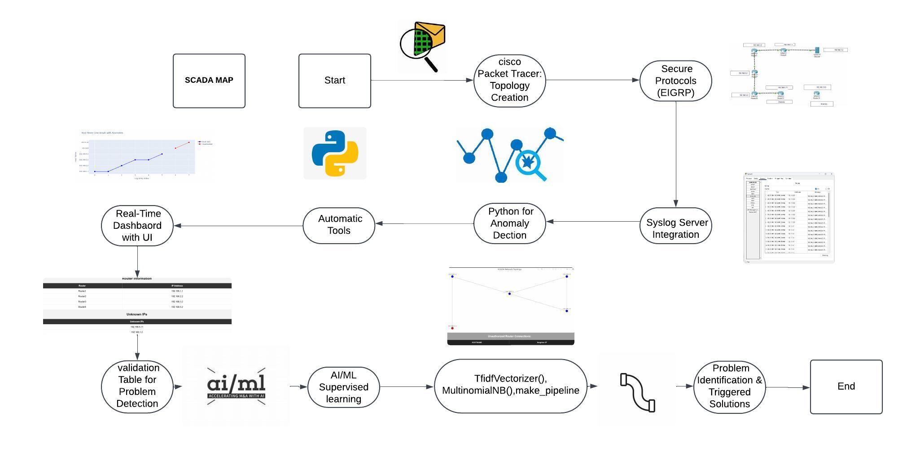
WORKFLOW:

Slide 5
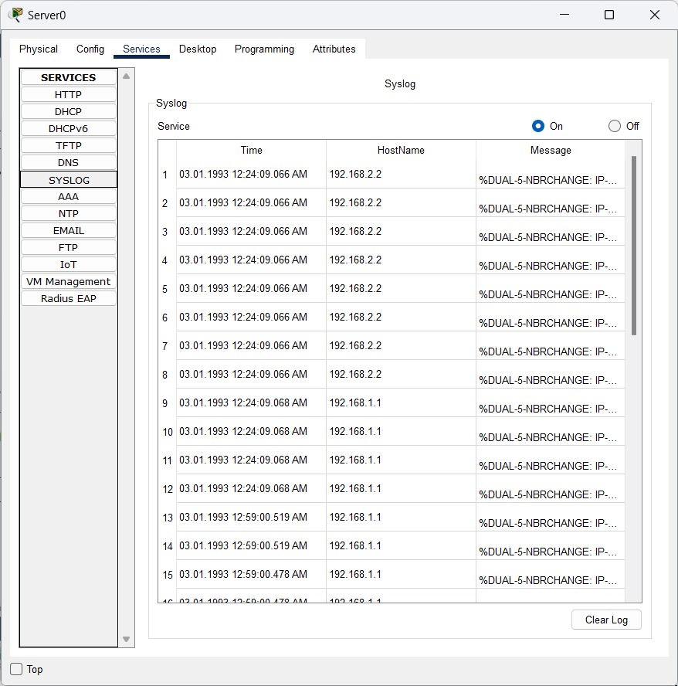
FEASIBILITY AND VIABILITY
DenQueue
Feasibility: | Viability:
Feasibility Analysis: Utilizes free, open-source technologies, making it affordable and practical to implement. Can be simulated in virtual environments (Cisco Packet Tracer) removing the need for physical hardware during development. Potential Challenges and Risks: Managing real-time network mapping and device identification across extensive geographic distances. Incorporating advanced security like blockchain without negatively affecting performance. Strategies for Overcoming Challenges: Implement distributed systems for real-time data collection and accurate mapping over large networks. Ensure blockchain and AI integration are streamlined to maintain high security without slowing down the system. Established Protocols Utilizes familiar protocols like EIGRP, ensuring smooth integration into existing networks. | Cost-Effective: Built using open-source technologies (Python, Naïve Bayes Classifier) to reduce implementation costs. Can be developed in virtual environments avoiding the need for physical hardware. Scalability: Designed for large-scale networks, with a distributed architecture that handles networks spanning thousands of kilometers. Real-time updates using syslog and routing data (EIGRP) ensure accurate network maps. High Security: AI-powered anomaly detection identifies security threats in real-time, ensuring proactive threat mitigation. AI/ML based device authentication secures access to critical infrastructure without compromising performance. Real-Time Monitoring: A web-based interface provides real-time network visualization and alerts, ensuring quick responses to security incidents.
Syslog Server:

Slide 6
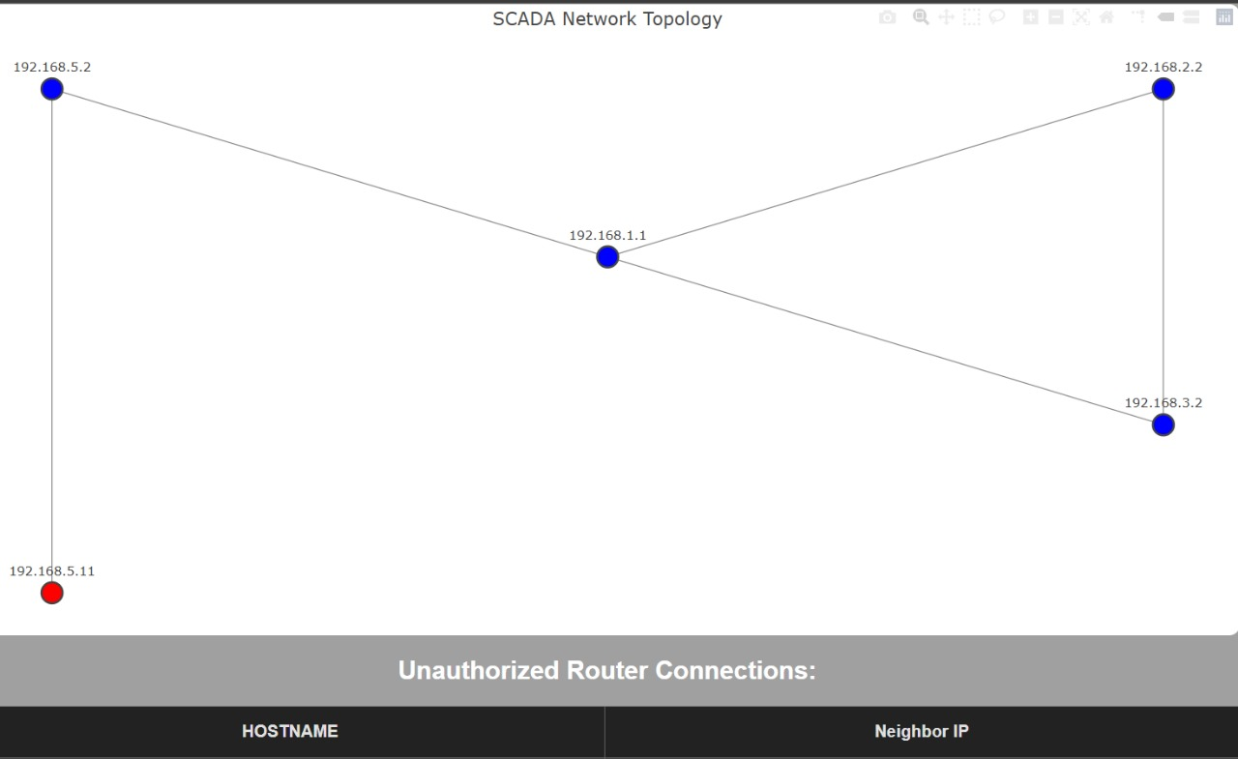
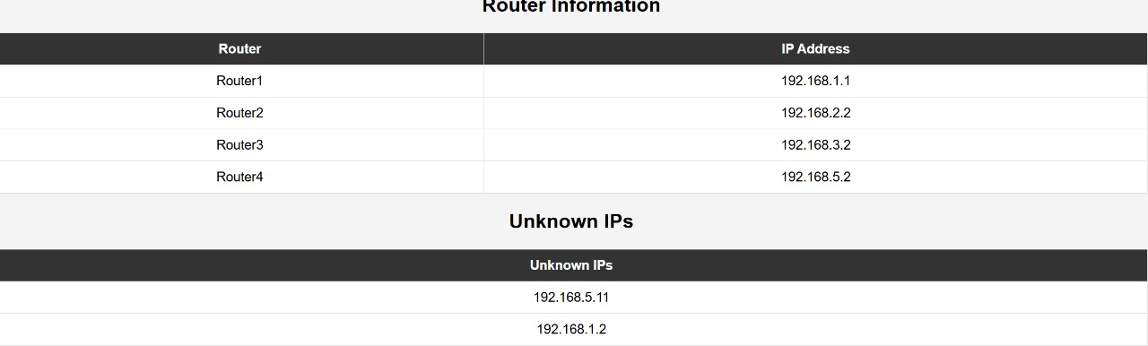
IMPACT AND BENEFITS
DenQueue
IMPACT | BENEFITS
Enhanced Network Security: Ensures the SCADA network is protected from unauthorized access and potential cyber-attacks. | Improved Efficiency: Automates topology discovery, reducing manual work and improving response times for network issues.
Real-Time Monitoring: Provides continuous, up-to-date visibility into network topology, helping reduce downtime and improve maintenance efficiency. | Cost-Effective Solution: Uses open-source tools and requires no additional hardware, making it a budget-friendly option.
Scalability for Large Networks: Capable of handling networks across thousands of kilometers, supporting large-scale infrastructure. | Secure Device Authentication: Blockchain integration ensures only authorized devices access the network, bolstering security.
Proactive Threat Detection: AI-driven anomaly detection enables faster identification of threats, leading to quicker responses and minimized risk. | User-Friendly Interface: Real-time visualization and alerts via an interactive web-based UI simplify network management for administrators.

Slide 7



RESEARCH AND REFERENCES
DenQueue
Reference:
This paper outlines the vulnerabilities of SCADA networks and their critical role in infrastructure, emphasizing security risks and solutions . Available at Science Direct- link
A detailed analysis of EIGRP features and the security implications for routing in critical networks like SCADA. Available at Cisco- link
A review of SNMPv3’s security features, including encryption and authentication, suitable for secure network topology discovery. Available Research gate- link
Research:
Research Paper: Security of Industrial Control Systems and SCADA Networks
This paper discusses the vulnerabilities in SCADA systems and how modern tools and
technologies address these vulnerabilities.
SUDHARSAN.K
Front- end Developer,
UI/UX Designer
RANJITH.R
Back-End Developer,
AI & ML Developer
SELVA VISHNU.G
Database Manager
asDManager
YASHRITHA.S
AI & ML Developer
SRIVARSHA.V.S
AI & ML Developer
SANTHOSH KUMAR.P
Network Security
MAIL ID: santhoshpalanisamy292@gmail.com

